Slide 1

Hotel Reservation Analysis
TEAM-4
Notes:
‹#›

Slide 2
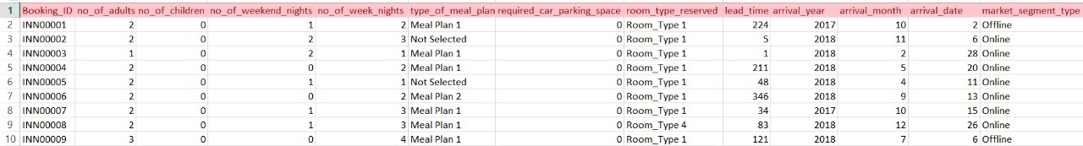
Raw Dataset Overview
Initial data collection before processing and validation
Guest Information
Booking Details
Financial Data
Demographics, repeat status, special requests
Dates, lead times, market segments
Pricing, revenue, payment methods
Notes:
‹#›

Slide 3
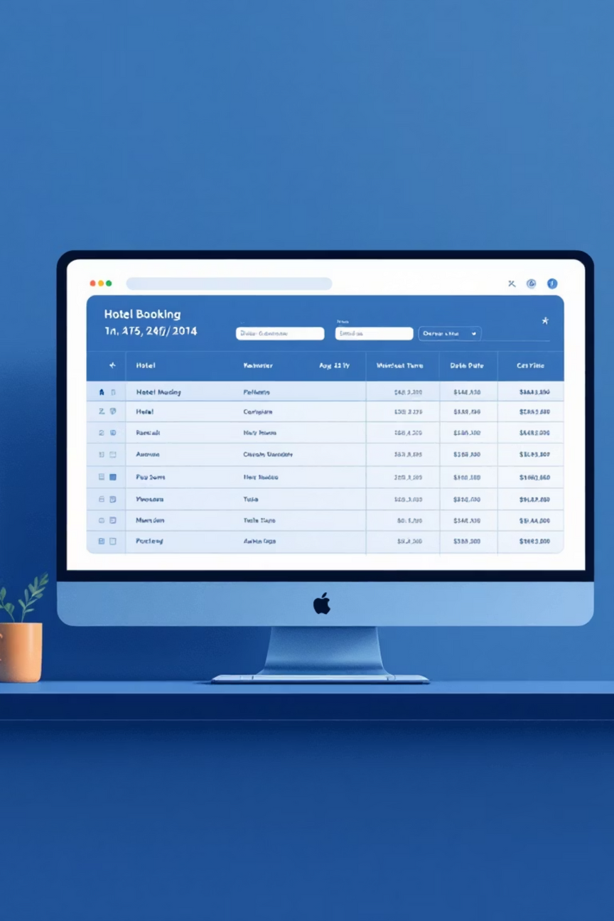
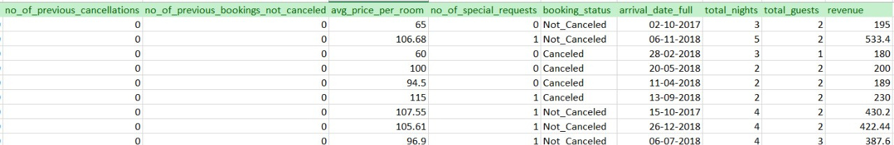

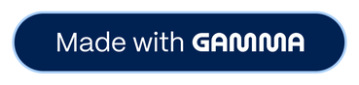
Cleaned Dataset
Refined data ready for strategic analysis
Data Validation
Field Standardization
Removed duplicates and inconsistencies
Normalized formats and categories
Quality Assurance
Verified accuracy and completeness
Notes:
‹#›

Slide 4
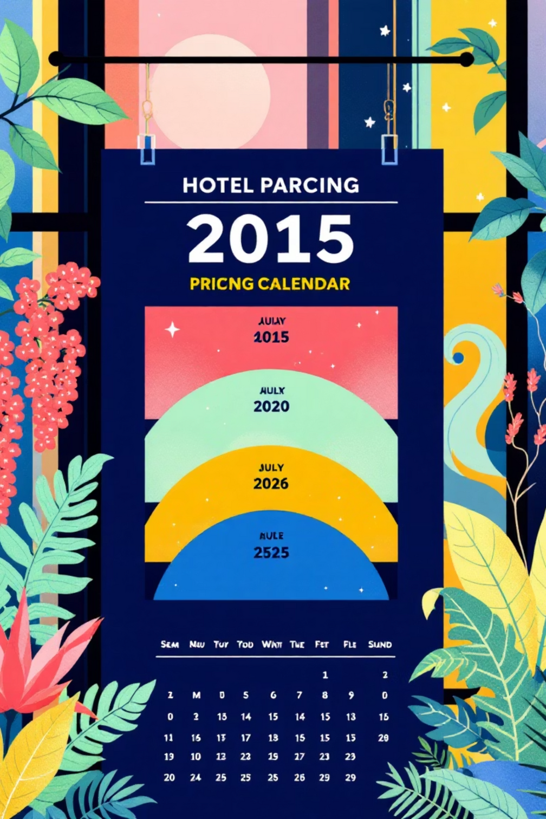
OVERVIEW PAGE
How does the Average Daily Rate (ADR) vary across months?
Insight
Shows seasonal trends in pricing—peak months may have higher ADR due to demand.
Overview
Helps revenue managers identify the best months for pricing strategies.
Implementation
Use dynamic pricing models to adjust ADR based on demand forecasts.
Benefits
Maximizes revenue in high-demand months and improves occupancy in low-demand months.
Notes:
‹#›

Slide 5

Which room types generate the highest total revenue?
Insight
Identifies top-performing rooms (e.g., deluxe vs. standard).
Overview
Useful for capacity planning and upselling strategies.
Implementation
Promote upselling and invest more in high-demand room types.
Benefits
Increases profit margins and improves customer satisfaction with preferred rooms
Notes:
‹#›

Slide 6


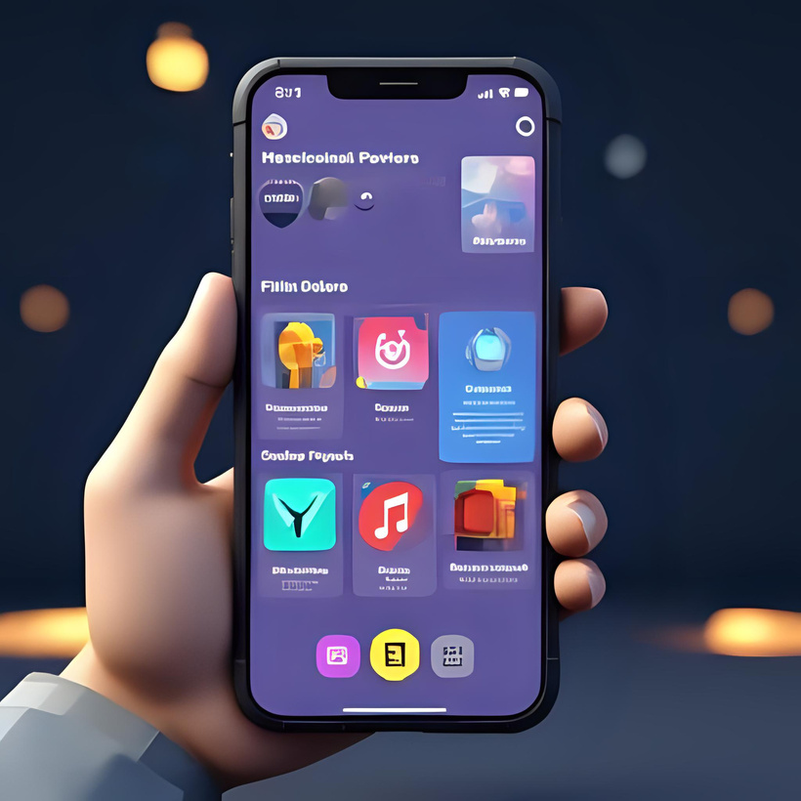


Segment
How many bookings come from each market segment ?
Insights:
Reveals customer acquisition channels’ effectiveness.
Overview:
Guides investment in marketing and partnerships
Implementation:
Benefits:
Strengthen partnerships with high-performing segments, reduce dependency on low-value channels.
Optimized marketing spend and better-targeted customer acquisition.
Notes:
‹#›

Slide 7








Which market segments bring the most revenue?
Insight
Overview
Not all segments with high bookings contribute equally to revenue.
Helps prioritize focus on high-value segments
Benefits
Implementation
Increased RevPAR through strategic focus
Prioritize high-value segment acquisition
Notes:
‹#›

Slide 8

What is the average length of stay across guests?
1
Insights:
Longer stays increase revenue stability.
2
Overview:
Useful for targeted packages (weekend vs. long-stay deals).
3
Implementation:
Create packages/discounts for longer stays.
Benefits: Higher occupancy stability and reduced operational costs per night.
Notes:
‹#›

Slide 9

Which meal plan (Meal plan 1,Meal plan 2,Meal plan 3,Meal plan 4) is most preferred by guests?
1
Insights:
Identifies customer preferences in F&B services.
2
Overview:
Guides kitchen operations and bundled offers.
3
Implementation
Customize meal plan offers (family packages, business combos).
Benefits: Increases F&B revenue and enhances guest experience
Notes:
‹#›

Slide 10

Booking Behavior
How many total nights are booked across different months/years?
Insight
Shows demand trends and seasonality.
Overview
Helps in forecasting occupancy.
Implementation
Align staffing and inventory with peak and off-season demand.
Benefits
Reduces overstaffing costs and ensures smooth operations during high demand.
Notes:
‹#›

Slide 11

What’s the booking trend across weekdays vs weekends?
Insight: Weekends may have higher stays; weekdays may show corporate demand.
Implementation: Offer weekend leisure packages and weekday corporate deals.
Benefits: Balances occupancy across the week and maximizes revenue per available room.
Notes:
‹#›

Slide 12

How far in advance do guests book rooms?
Insight: Longer lead times = leisure bookings; shorter = business or last-minute.
Overview: Guides cancellation policies and dynamic pricing.
Implementation: Apply stricter cancellation rules for early bookings, offer discounts for last-minute stays.
Benefits: Reduces revenue loss from cancellations and attracts spontaneous travelers.
Notes:
‹#›

Slide 13

Which market segments have the highest cancellation rates?
Insights:
Overview:
Implementation
OTA segments may cancel more than corporate.
Helps reduce risk by revising policies for high-cancellation sources.
Introduce stricter cancellation penalties or prepayment options for OTA bookings.
Benefits:
Reduces cancellations and improves booking reliability.
Notes:
‹#›

Slide 14

Do cancellations vary by room type?
Insights:
Certain room categories may attract more speculative bookings
Overview:
Helps in overbooking strategies.
Implementation:
Apply overbooking buffers on high-cancellation room types.
Benefits:
Increases occupancy rate and reduces revenue leakage.

Slide 15

Conclusion:
Provides clear insights into guest behavior, pricing trends, and cancellations.
Helps understand who the guests are, how they book, and what they prefer.
Enables hotels to improve services based on guest preferences.
Assists in reducing cancellations by identifying patterns.
Supports maximizing revenue through better pricing strategies.
Overall, helps in making smarter business decisions.
Contributes to creating a better guest experience.
Notes:
‹#›

Slide 16
THANK YOU
Notes:
‹#›

